Slide 1
Classes and Objects
Cheltenham Hackspace Python Course
Week 7

Slide 2
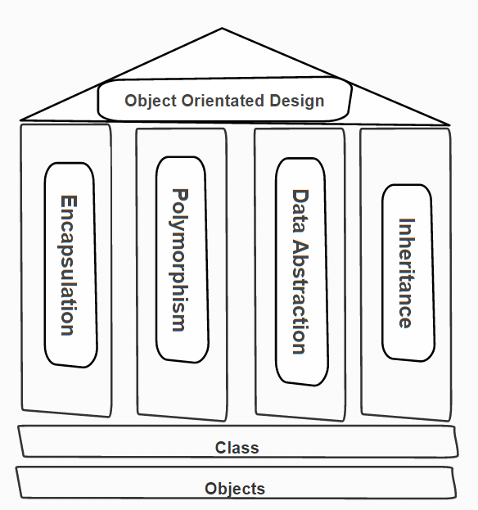
Object Orientated Programming
A software design paradigm
Based on 3/4 pillars
Encapsulation
Polymorphism
Inheritance
Data Abstraction
Some do not include this.
Classes and Objects then form the foundations

Slide 3
Pillar - Abstraction
“Abstraction is the process by which data and programs are defined with a representation similar in form to its meaning, while hiding away the implementation details.”
Representation
Classes and objects are used to model real world objects (and concepts)
Hiding implementation
A well designed class hides away the implementation details to allow it to be reused. This also means that we can modify a class without users knowing as long as we keep the interface the same.

Slide 4
Pillar - Encapsulation
“Encapsulation is a mechanism of wrapping the data (variables) and code acting on the data (methods) together as a single unit. The variables of a class will be hidden from users, and can be accessed only through the methods of their current class, therefore it is also known as data hiding”
Encapsulation supports data abstraction by hiding the state (variables) of an object.
It then exposes functions (methods) to form an interface to make use of the hidden data.

Slide 5
Pillar - Encapsulation
In other OO languages encapsulation is enforced (i.e. you cannot directly access a variable within a class).
However, as python is a “dynamic” language it is not enforced.
Therefore there is a convention when naming variables
Start the variable name with an underscore, i.e.
_some_var = “a value”
By marking a variable with an underscore you are effectively saying “This is a private variable”
Important not to use these variables outside of the class as they may change without warning (i.e. they do not form the contract of the class)

Slide 6
Pillar – Inheritance
“Inheritance allows a class to use the properties and methods of another class”
The idea for this pillar is that we can create new classes that are based upon existing classes therefore extending functionallity

Slide 7
Pillar - Polymorphism
“The ability to appear in many forms. In object-oriented programming, polymorphism refers to a programming language's ability to process objects differently depending on their data type or class”
In other languages polymorphism is key to design. It allows us to define an interface that classes implement. This allows us to choose the implementation that fits the situation at run time.
However, python is a dynamic language and we can do this without polymorphism.

Slide 8
Classes and objects
Question
“What is the difference between a Dog and an Jack Russell Terrier?”

Slide 9
Classes and objects
Question
“I have three Jack Russell Terriers; Fido, Skip and Rover. What is the difference between Fido, Skip and Rover?”

Slide 10
Classes and objects
Dog and Jack Russell Terriers are not real things they are just words that we attach to instances of things that share common features. They are abstractions that allow us to model the world.
Fido, Skip and Rover are instances of Jack Russel Terriers (and more generically dogs). They are concrete entities that we can interact with in the real world.
In OO terms:
Dog and Jack Russell Terriers are classes
Fido, Skip and Rover are objects.

Slide 11
Classes and object - code
Demo

Slide 12
Classes and objects - self
The self key word is always the first parameter in a function defined within a class.
This allows the function access to variables stored within the class for example:
def getName(self):
return self.name
Check for this if your function does not have the desired effect on your variables.

Slide 13
Classes and objects - constructor
The constructor is called when an object is created.
This allows configuration of an object at run time
Defined in function __init__, for example:
def __init__(self, colour):
self.colour = colour
This is then called when you create an object, e.g.:
black_dog = Dog(“black”)# the colour property of this dog will be “black”
white_dog = Dog(“white”)# the colour property of this dog will be “white”

Slide 14
Classes and objects - exercise
Complete the exercises within PyCharm Edu for “Classes and objects”
As an extra, create the classes that could be used for a fictional vehicle hire company.
Consider:
Using inheritance to give a base class
Setting properties as high up the inheritance as possible – Override them as required
The classes must cover different types of vehicle, e.g Motorbike, Car, Van, Lorry, (Plane?)
The classes must also cover different makes/models of a specific type.
Use both variables and functions
Create instances of these classes and print output to screen

